Slide 1
AI FUNDAMENTALS
Madison College
Week 01
Part 2: History of AI

Slide 2
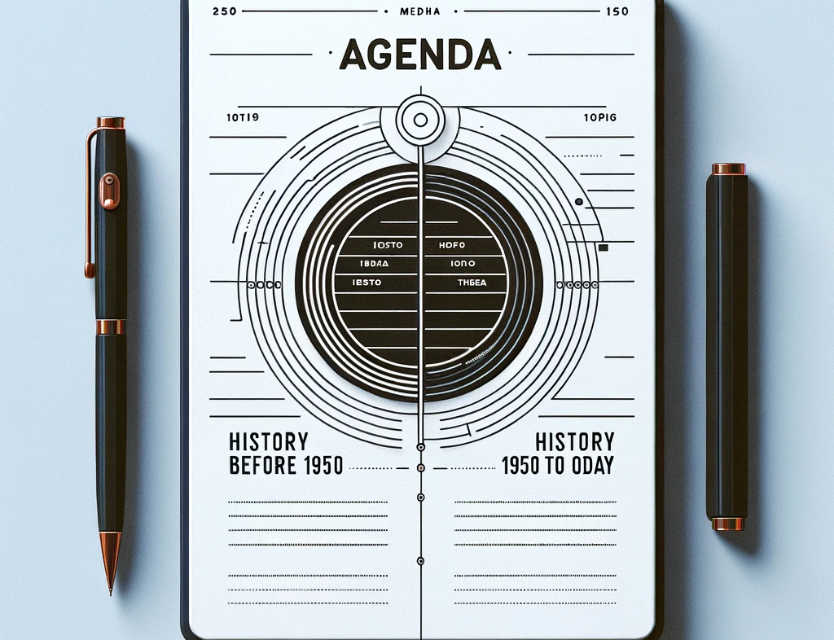
TOPICS
History before 1950
History 1950 to Today
Notes:
In a previous slide set and lecture, we covered the definition, origin, and types of AI with a focus on their capabilities and functionalities.
In this slide deck and lecture, we will continue to understand how AI has evolved, taking a historical journey starting from before 1950, capturing the early concepts and theories, and move through to the significant advancements from 1950 to the present day.
This will give us a comprehensive view of how AI has transformed over the decades and how it continues to shape our future.

Slide 3
History of AI
Before 1950

Slide 4
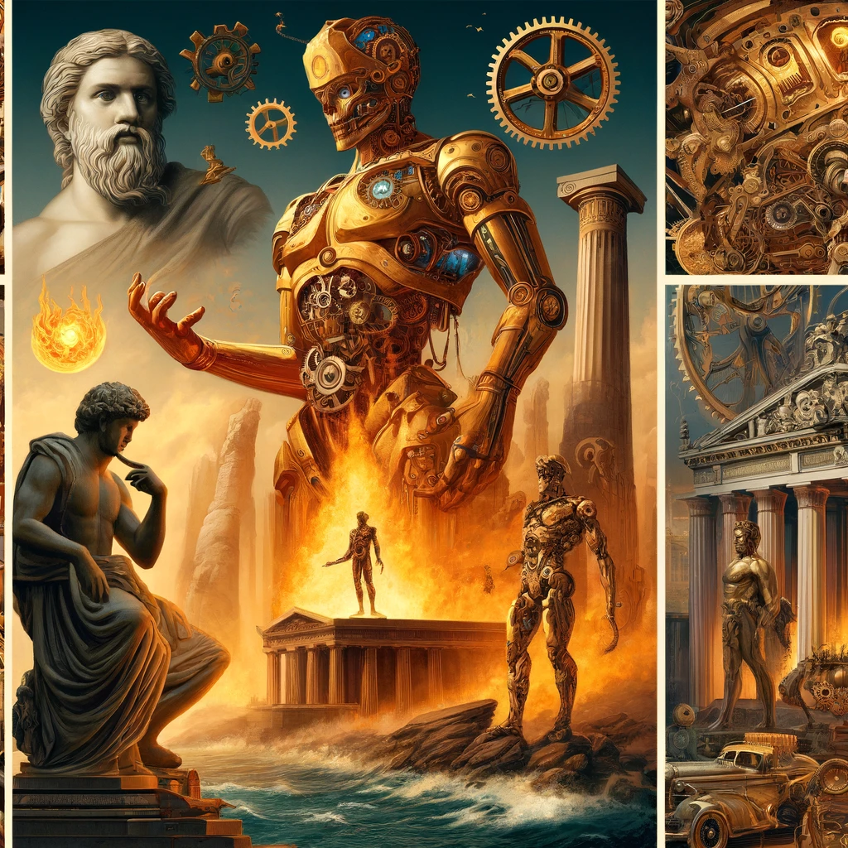
Myths & Early Concepts of Automata
Hephaestus and his mechanical servants
Talos, the bronze automaton
Pygmalion’s animated statue
Notes:
Before the formal conception of AI, myths and legends explored the creation of life-like machines and animated figures.
Hephaestus, the god of metalworking, was said to have crafted mechanical servants to assist him, embodying early human dreams of automata.
Similarly, Talos, a giant bronze protector, represents one of the first ideas of a robot used for military and protective purposes.
The story of Pygmalion, who carved a statue that was brought to life, further illustrates ancient fascinations with animating the inanimate, highlighting a deep-rooted allure towards creating and imbuing life through art and technology.

Slide 5
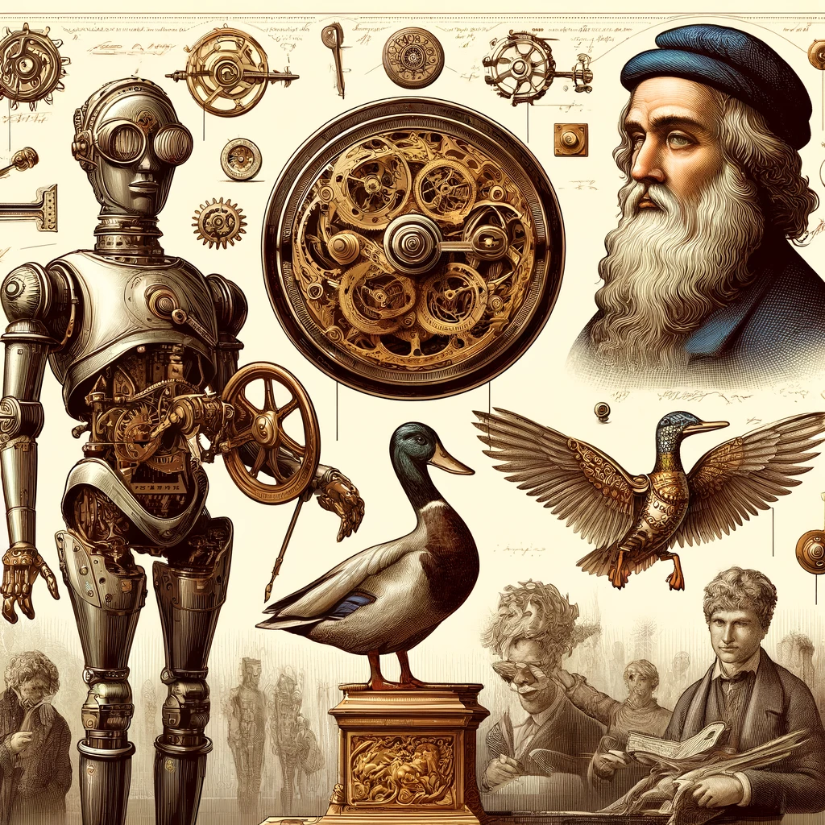
Mechanical Ingenuity in the Renaissance and Enlightenment
The Antikythera Mechanism, an ancient Greek analog computer
Leonardo da Vinci’s Mechanical Knight
Jacques de Vaucanson's Digesting Duck
Notes:
The path toward AI was significantly advanced during the Renaissance and Enlightenment with the creation of complex mechanical devices.
The Antikythera Mechanism, dating back to around 100 BCE, used gears to predict astronomical positions, representing one of the earliest forms of computing.
Leonardo da Vinci’s Mechanical Knight, designed in the late 15th century, could simulate human gestures, marking a significant step towards humanoid robotics.
In the 18th century, Jacques de Vaucanson amazed audiences with his mechanical duck that could mimic the act of eating and digesting grain, showcasing early robotic behavior simulation.

Slide 6
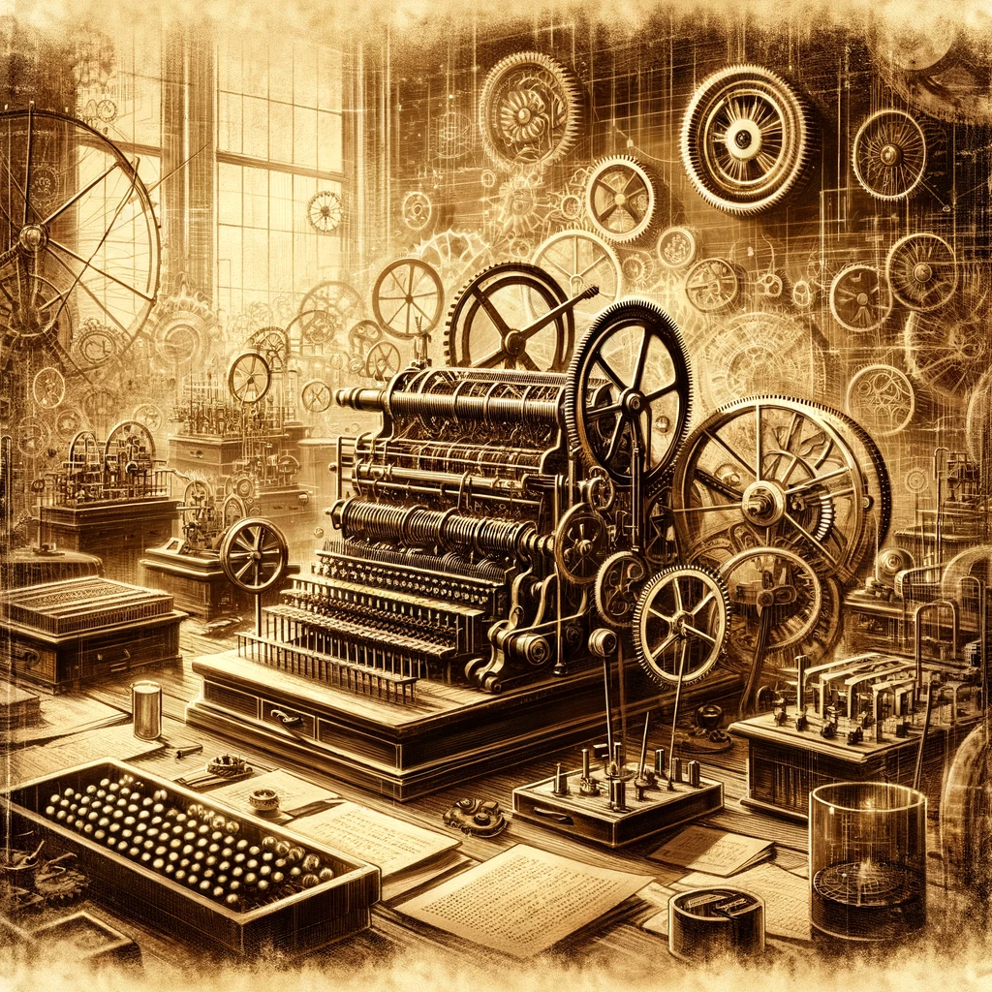
Foundations of Computational Theory
Charles Babbage's Analytical Engine
Ada Lovelace’s first algorithm
Boolean Algebra by George Boole
Notes:
In the 19th and early 20th centuries, the foundations of computational theory were laid, setting the stage for modern AI.
Charles Babbage designed the Difference Engine and later the Analytical Engine, which used punch cards to perform calculations, conceptualizing the first general-purpose computing machine.
Ada Lovelace, recognized as the first computer programmer, wrote algorithms for the Analytical Engine and foresaw its potential beyond mere calculation.
George Boole introduced Boolean Algebra, essential for the development of digital logic and computer science, crucial components of AI.

Slide 7
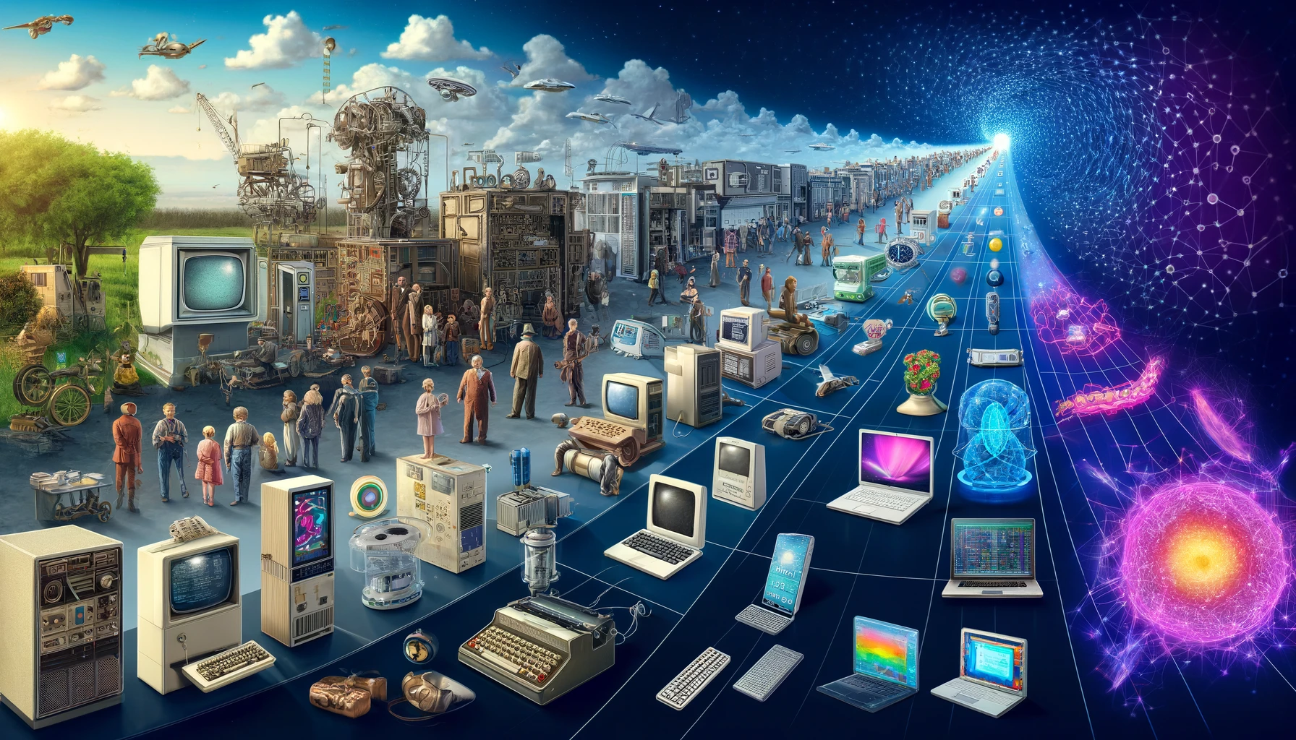
HISTORY OF AI
1960
2020
1950
2010
2000
1990
1980
1970
1950 to Today

Slide 8
1950
Alan Turing Turing Test
1956
Dartmouth Conf “Artificial Intelligence”
2020
1960
1950
2010
2000
1990
1980
1970
1957
Frank Rosenblatt Perceptron
Notes:
In the 1950s, the field of artificial intelligence began to take shape through a series of pivotal developments that laid the philosophical, technical, and practical foundations of AI.
The decade opened with Alan Turing's groundbreaking proposal of the Turing Test in 1950, a concept that continues to influence AI philosophy and ethics. The Turing Test was designed to assess a machine's ability to exhibit intelligent behavior indistinguishable from that of a human.
Turing's work in his paper 'Computing Machinery and Intelligence' established a benchmark for evaluating machine intelligence and sparked a broader discussion about the potential and limits of artificial intelligence.
In 1956, the Dartmouth Conference marked a significant milestone in AI's history. Organized by John McCarthy, Marvin Minsky, Nathaniel Rochester, and Claude Shannon, the conference brought together experts across disciplines to discuss the potential of machines to simulate human intelligence. This event is celebrated as the formal birth of artificial intelligence as a distinct field of study, where the term 'artificial intelligence' itself was coined, crystallizing its identity and objectives.
Following this, in 1957, Frank Rosenblatt made a critical advancement with the invention of the Perceptron, an early neural network model. The Perceptron introduced key concepts of machine learning such as adjustable weights and activation functions, setting the stage for more complex algorithms and models that would follow.
Despite these significant strides, the 1950s also saw the seeds of future challenges, with early over-enthusiasm leading to what would become known as the AI winter. The initial excitement generated unrealistic expectations that the existing technology and theoretical understanding could not yet fulfill, resulting in a backlash that cooled interest and funding for AI research.
Together, these moments from the 1950s reflect the era's profound impact on the trajectory of AI, characterized by groundbreaking ideas and cautionary tales of overreach. As we explore these beginnings, we not only recognize the ingenuity of the pioneers but also learn from the early missteps that shaped AI’s developmental path."

Slide 9
1960
Newell & Simon
General Problem Solver
1965
Joseph Weizenbaum
ELIZA
1966
SRI International
Shakey the Robot
1960
2020
1950
2010
2000
1990
1980
1970
Notes:
The 1960s marked a period of enthusiastic exploration and notable achievements in artificial intelligence, encompassing advancements across problem-solving, natural language processing, and robotics.
In 1960, Allen Newell and Herbert A. Simon introduced the General Problem Solver, an innovative program designed to address a wide variety of problems through heuristic techniques. This system initially tackled challenges in domains such as geometry and logic, evolving by 1967 into the Universal Problem Solver with enhanced flexibility and expanded capabilities.
Mid-decade, in 1965, Joseph Weizenbaum developed ELIZA, a program that fundamentally altered the landscape of human-computer interaction. ELIZA used simple pattern-matching techniques to simulate conversation, effectively acting as an early chatbot. Its iteration as a Rogerian psychotherapist the following year highlighted the potential for machines to mimic human-like interactions, setting a precedent for the development of modern conversational agents.
The innovation continued in 1966 with the development of Shakey the robot by SRI International. Shakey was the first general-purpose mobile robot capable of autonomous navigation and reasoning about its actions. Equipped with cameras and sensors, Shakey could navigate complex environments and manipulate objects, laying foundational concepts for future autonomous systems.
However, the decade also witnessed significant setbacks, particularly in 1969, when Marvin Minsky and Seymour Papert's publication 'Perceptrons' critiqued the limitations of neural networks, particularly their inability to process complex patterns. This influential book triggered a decline in interest and funding for neural network research, setting the stage for the first AI winter.

Slide 10
1970
1972
1973
Terry Winograd SHRDLU
1960
2020
1950
2010
2000
1990
1980
Colmerauer & Roussel
PROLOG
1970
Edward Shortcliffe
MYCIN
Notes:
The 1970s were a transformative decade for AI, characterized by groundbreaking advancements and stark realizations of the field's limitations.
The decade began with Terry Winograd's development of SHRDLU in 1970. This program was a significant leap forward in natural language processing, enabling computers to understand and manipulate objects in a simulated block world. SHRDLU's interaction model provided a new way to think about and implement AI interactions.
In 1972, Alain Colmerauer and Philippe Roussel developed PROLOG, a programming language that became instrumental in the field of logic programming and AI research. PROLOG's introduction marked a crucial advancement in the tools available for developing AI applications.
The successes continued in 1973 with the creation of MYCIN by Edward Shortliffe. MYCIN was an expert system designed to diagnose and treat bacterial infections, showcasing the effective application of AI in medicine and setting a benchmark for future expert systems.
Despite these advances, the decade also faced significant challenges. The publication of the Lighthill Report in 1973 critically assessed the state of AI research in the UK, concluding that it fell short of its lofty expectations, particularly in achieving general intelligence. The skepticism expressed in the report led to major cuts in AI research funding in the UK and dampened global enthusiasm for the field. This culminated in the onset of the first AI Winter in 1974, a period marked by reduced funding and waning interest, highlighting the gap between ambitious expectations and the reality of AI capabilities at the time

Slide 11
1985
Sutton & Barto
Reinforcement Training
1986
1960
2020
Hinton & Rumelhart
Backpropagation
1950
2010
2000
1990
1980
1970
Yann LeCunn
Convolutional Neural Networks (CNNs)
1989
Notes:
The 1980s were marked by critical advancements that shaped the core methodologies of AI research and application, spearheading the development of techniques that are foundational to modern AI.
In 1985, Richard Sutton and Andrew Barto introduced the concept of reinforcement learning. This method, based on learning through trial and error, became a cornerstone for training AI systems, influencing how artificial intelligence is taught to navigate complex decision-making processes.
The following year, Geoffrey Hinton and David Rumelhart popularized backpropagation for training neural networks. This technique became instrumental in the development of deep learning, paving the way for AI systems that could learn from vast amounts of data and improve over time.
In 1989, Yann LeCun introduced Convolutional Neural Networks (CNNs), specifically designed for processing visual data such as images. This innovation revolutionized computer vision, enabling significant advancements in tasks such as image and facial recognition.
However, the late 1980s also witnessed the onset of the second AI Winter. This period was characterized by significant skepticism and underwhelming results, which led to reduced investments and a decline in the development of AI projects. The technological limitations of the time and a nascent understanding of machine learning contributed to the commercial failures of AI applications, setting back the field's progress.

Slide 12
IBM Deep Blue
1997
Rodney Brooks
Behavior-based Robotics
1960
2020
1990
1950
2010
2000
1980
1999
1970
Fei-Fei Li
Image Net
1999
Notes:
The 1990s saw pivotal shifts in both the theoretical underpinnings and practical applications of AI.
In 1997, IBM's Deep Blue made history by defeating world chess champion Garry Kasparov. This victory showcased AI's capabilities in solving complex strategic problems, highlighting its potential in game-playing scenarios.
Rodney Brooks' work on behavior-based robotics in 1999, including the development of the Roomba, demonstrated practical AI applications in autonomous robots, making a significant impact on everyday technology.
That same year, Fei-Fei Li launched the ImageNet database. ImageNet provided a massive, structured dataset that greatly accelerated advancements in machine vision, enabling the development of powerful image recognition algorithms that are foundational to modern computer vision applications.
However, the 1990s also brought a reality check for AI. Despite significant advancements, AI systems remained highly specialized, excelling only in narrow domains. The decade ended with a wave of disillusionment about the broader capabilities of AI, leading to a sobering adjustment of expectations across the industry

Slide 13
2006
Geoffrey Hinton
2008
Google
2009
IBM
Deep Learning
Voice Search
Watson
1960
2020
1950
2010
2000
1990
1980
1970
Notes:
The 2000s were a decade of significant milestones that expanded AI's reach and demonstrated new capabilities.
In 2006, Geoffrey Hinton and his team introduced techniques that significantly improved deep neural networks, ushering in the modern era of deep learning. This development led to breakthroughs in numerous AI applications across various sectors.
In 2009, IBM's Watson showcased its prowess by defeating human champions on the game show Jeopardy. This achievement demonstrated the potential of AI in processing and understanding natural language at a high level.
Google Voice Search, introduced in 2008, allowed users to perform searches by simply speaking their queries. This innovation made technology more accessible and integrated AI more deeply into daily life.
Despite these advancements, the decade also saw notable failures. The 2003 Mars Rover mission highlighted the challenges of deploying AI in unstructured environments due to software errors. Moreover, the Semantic Web project failed to gain widespread adoption, showcasing the complexities of applying semantic technologies at a large scale.

Slide 14



2016
Google
AlphaGo Victory
2018
Google
Duplex
1960
2020
2010
1950
2000
1990
1980
1970
2018
OpenAI
GPT-2
Notes:
The 2010s marked a decade of impressive achievements and some notable setbacks in AI.
In 2016, Google DeepMind's AlphaGo defeated world champion Lee Sedol in the complex game of Go, signaling a significant leap in AI's strategic thinking capabilities.
Google Duplex was introduced in 2018, using AI to conduct natural-sounding conversations to manage appointments and reservations, demonstrating advanced capabilities in human-AI interaction.
However, this decade also saw its share of controversies. In 2018, Amazon's AI recruiting tool was found to exhibit bias against women, and the Cambridge Analytica scandal involving Facebook highlighted severe concerns about data privacy and misuse in AI applications.
Despite these challenges, the decade laid the groundwork for AI's future, pushing the boundaries of what artificial intelligence can achieve while also serving as a reminder of the ethical and practical challenges that lie ahead.

Slide 15
2020
OpenAI
GPT-3
DeepMind
AlphaFold
1960
2010
1950
2000
1990
1980
2020
2020
1970
2021
OpenAI
DALL-E
Notes:
The 2020s have witnessed groundbreaking developments in AI that continue to push the boundaries of technology and its applications. In 2020, OpenAI released GPT-3, an advanced iteration of the Generative Pre-trained Transformer series. This AI model has dramatically enhanced natural
language understanding and generation, supporting a wide array of applications from automated content creation to sophisticated dialogue systems.
That same year, DeepMind's AlphaFold made a monumental breakthrough by solving the protein folding problem, which has been a major challenge in biology for decades. This achievement not only showcases the practical applications of AI in science but also opens up new possibilities for medical research and drug discovery.
Additionally, 2021 saw the introduction of DALL·E by OpenAI, an AI program capable of creating images from textual descriptions. This tool further exemplifies the expanding capabilities of AI in creative fields, pushing the frontiers of art and design with machine learning.
However, the decade has also been marked by significant challenges and setbacks. In 2020, controversies such as the Twitter algorithmic bias in image cropping and the UK government’s decision to scrap an algorithm designed to grade student exams highlighted ongoing issues with bias and fairness in AI systems. These incidents underscore the critical need for rigorous ethical standards and robust oversight in AI development to prevent bias and ensure fairness.
As we continue through the decade, these developments and challenges define the dual narrative of AI's potential to revolutionize industries and the imperative to address the ethical and societal implications of this powerful technology.

